Slide 1
Machine Learning Term Project
정두화, 이정명, 최찬영, 허서윤

Slide 2
100%
Dataset
&
Project Idea
Schedule
&
Collaboration Plan
Project title
01
02
03

Slide 3

01
Project Title

Slide 4
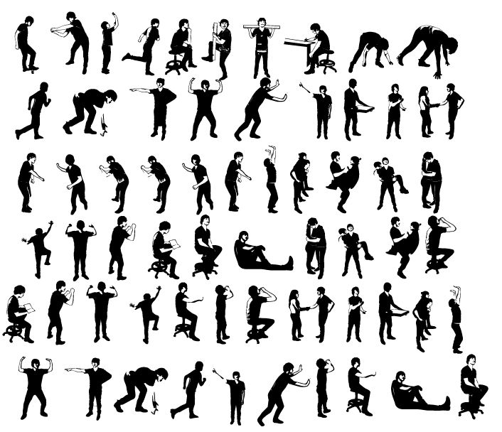
100%
Project Title
Watching motion and predicting what action to take

Slide 5
02
Dataset & Project Idea

Slide 6
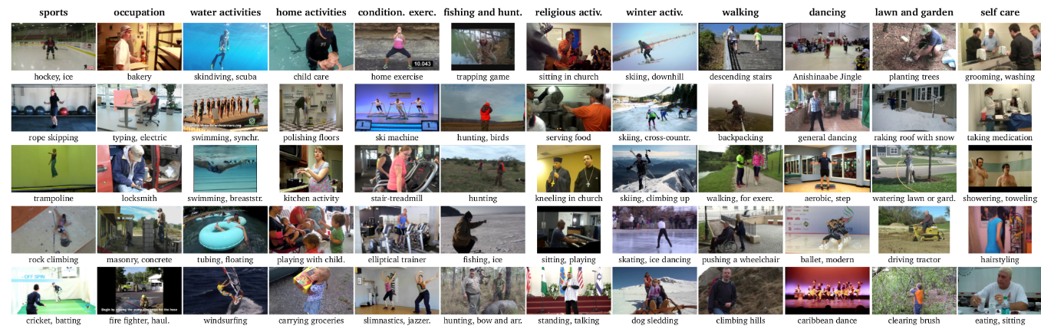
100%
Dataset
MpII Human Pose Dataset in Kaggle
MPII Human Pose dataset is a state of the art benchmark for evaluation of articulated human pose estimation. The dataset includes around 25K images containing over 40K people with annotated body joints. The images were systematically collected using an established taxonomy of every day human activities. Overall the dataset covers 410 human activities and each image is provided with an activity label.
Dataset URL : https://www.kaggle.com/nicolehoelzl/mpii-human-pose-data

Slide 7
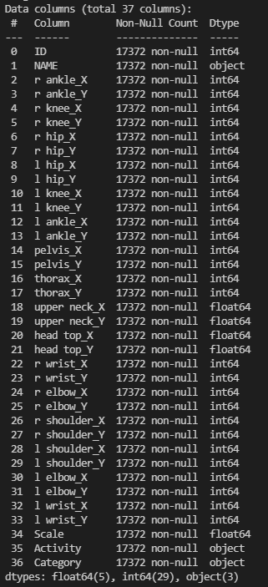
100%
Datasize
17372 rows X
37 attributes

Slide 8
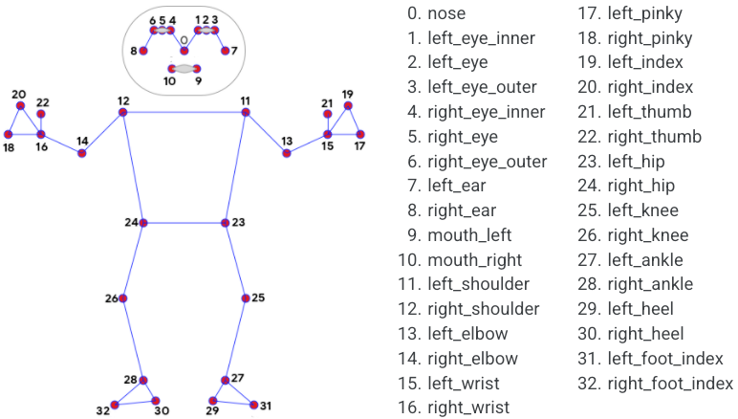
100%
Library
Motion Tracking Library
Dataset URL : https://google.github.io/mediapipe/solutions/pose.html

Slide 9
100%
Library
Problem
Solution
Get the value through other features.
Example)
-The average of both hips -> pelvis
-The average of both shoulders and pelvis's 2:1 endocrine point -> torax
-The average point of both shoulders and nose -> upper neck
-The outer part of the shoulders and nose -> head top
Among these columns, pelvis, thorax, head top, upper neck will be excluded.
Dataset URL : https://google.github.io/mediapipe/solutions/pose.html

Slide 10
100%
Project Idea
We will create a program to
“find out what posture this person is currently taking”
by using a dataset with coordinates for each body part.
Motion Tracking
&
Extract pose (x,y)
YOGA
input
output
Preprocessing
Find Best Model
Fitting Model

Slide 11
100%
Classification Algorithm
Clustering Algorithm
Decision tree
2. Logistic regression
3. SVM
Meanshift
K-Means
GMM
AgglomerativeClustering
Most influence the classification accuracy in Dataset
Col 2 ~ Col 33 in dataset A have a joint point. The pose has to be combined with each feature, so it is expected that it will inevitably affect all of the classifications.

Slide 12
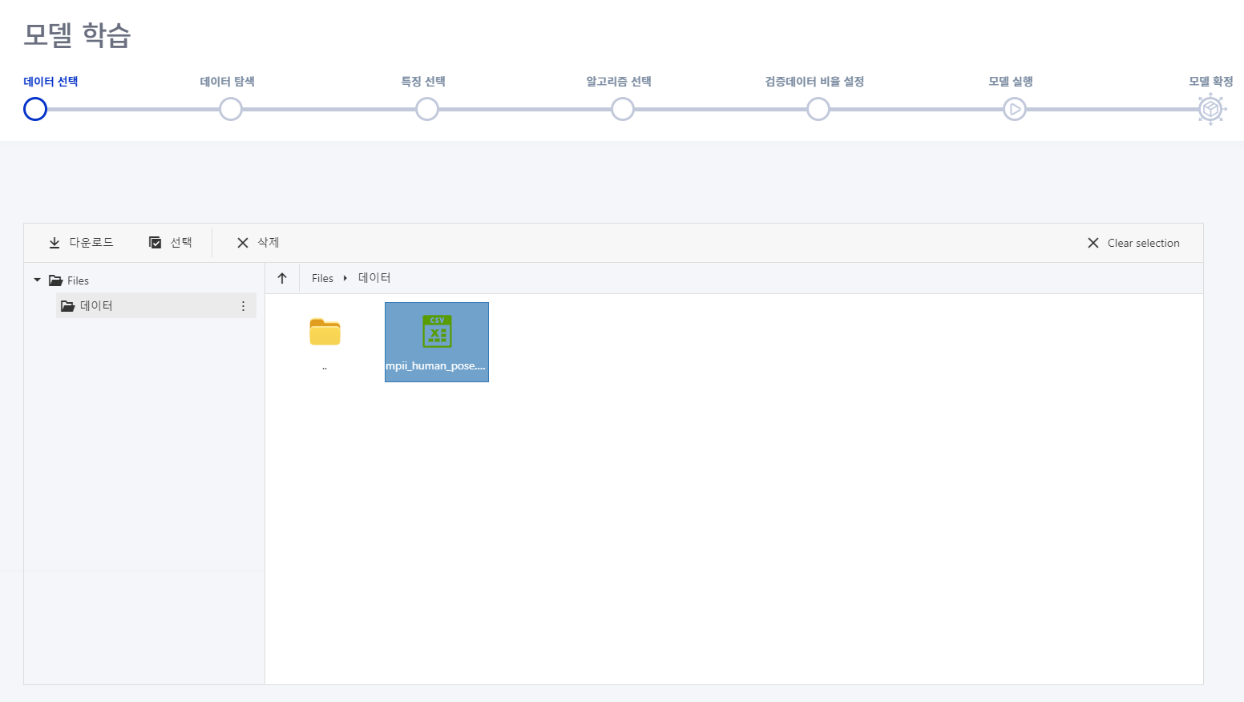
100%
Auto ML
URL : http://prophet.wise.co.kr

Slide 13
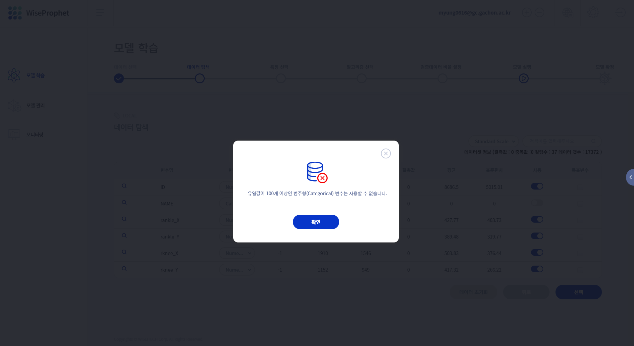
100%
Auto ML
URL : http://prophet.wise.co.kr

Slide 14
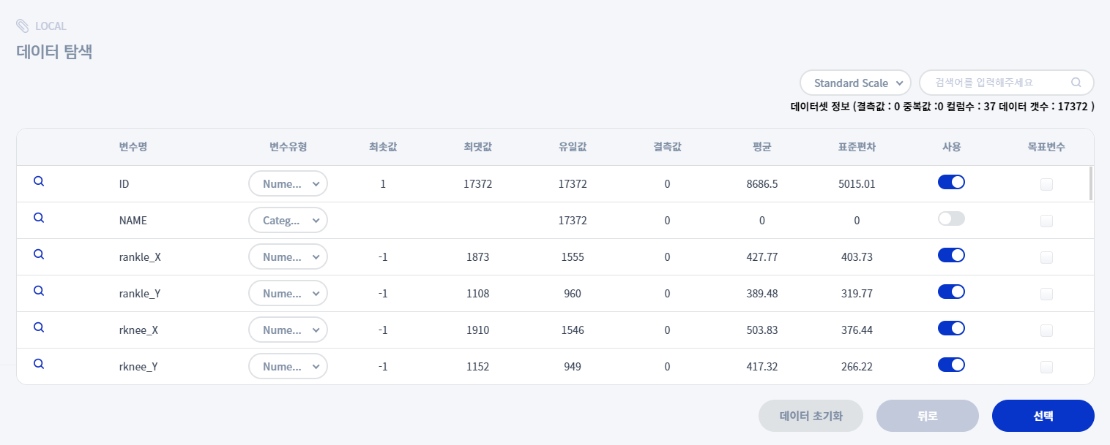
100%
Auto ML
URL : http://prophet.wise.co.kr

Slide 15
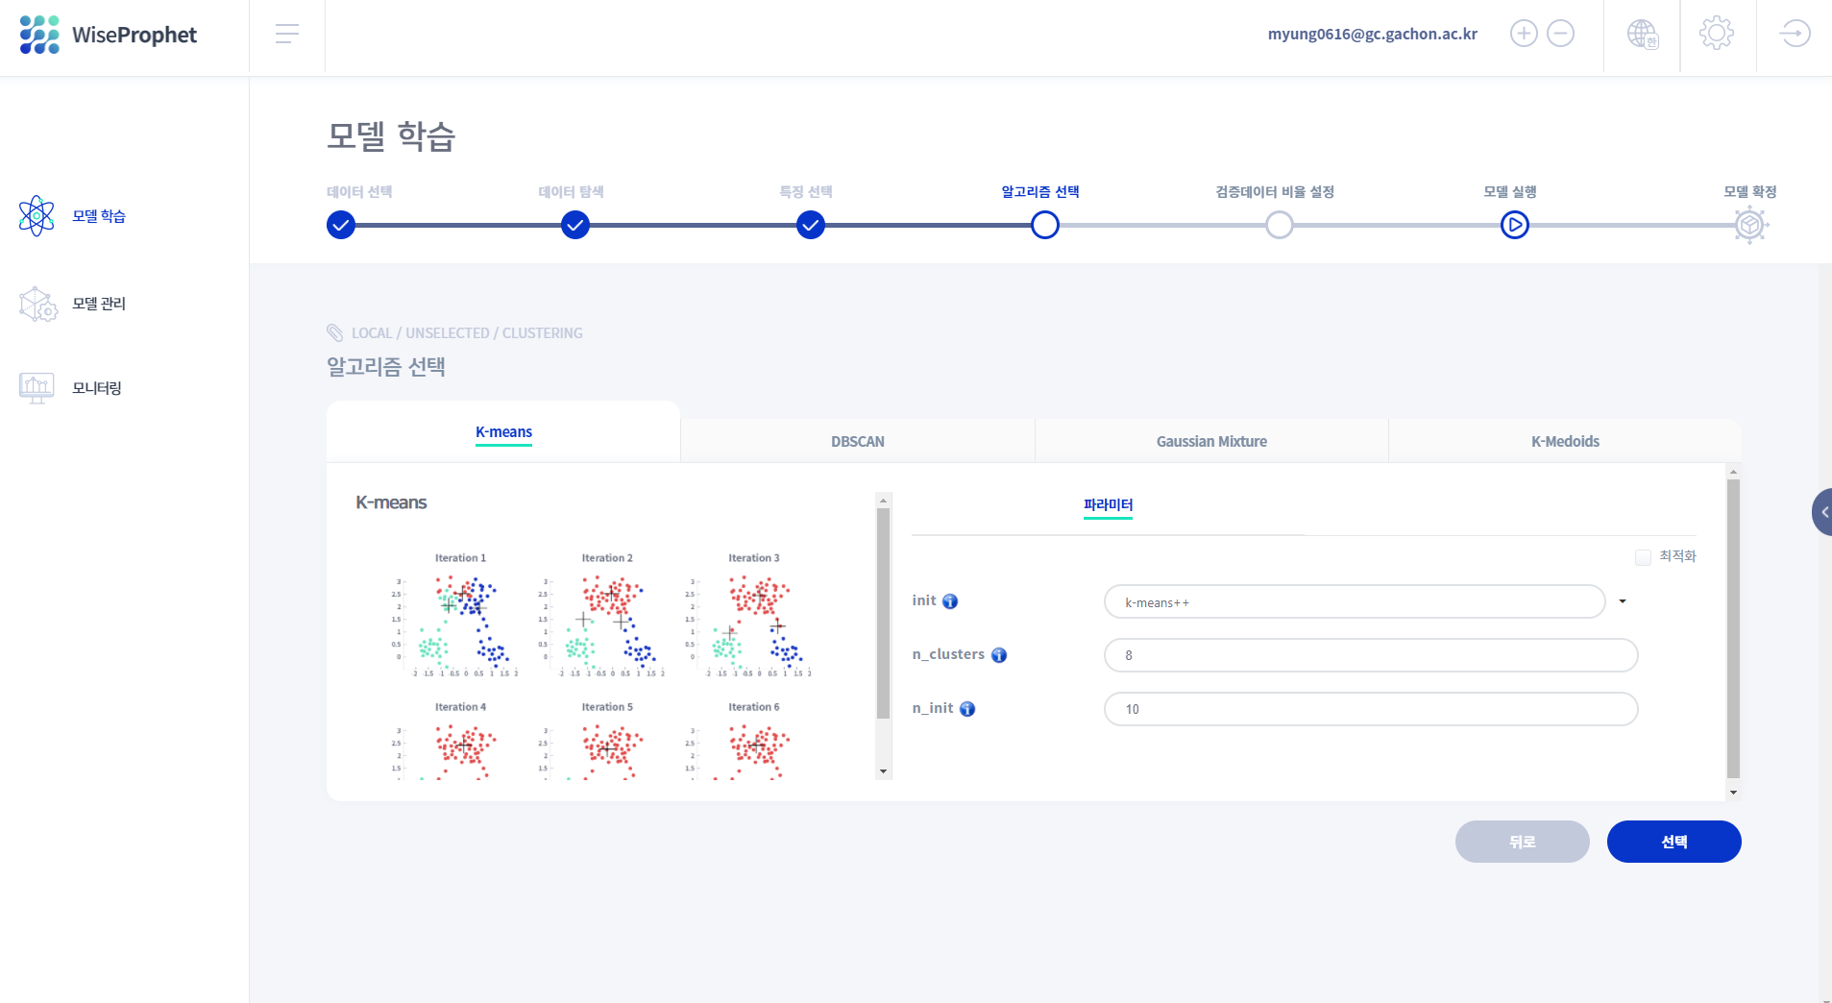
100%
Auto ML
URL : http://prophet.wise.co.kr

Slide 16
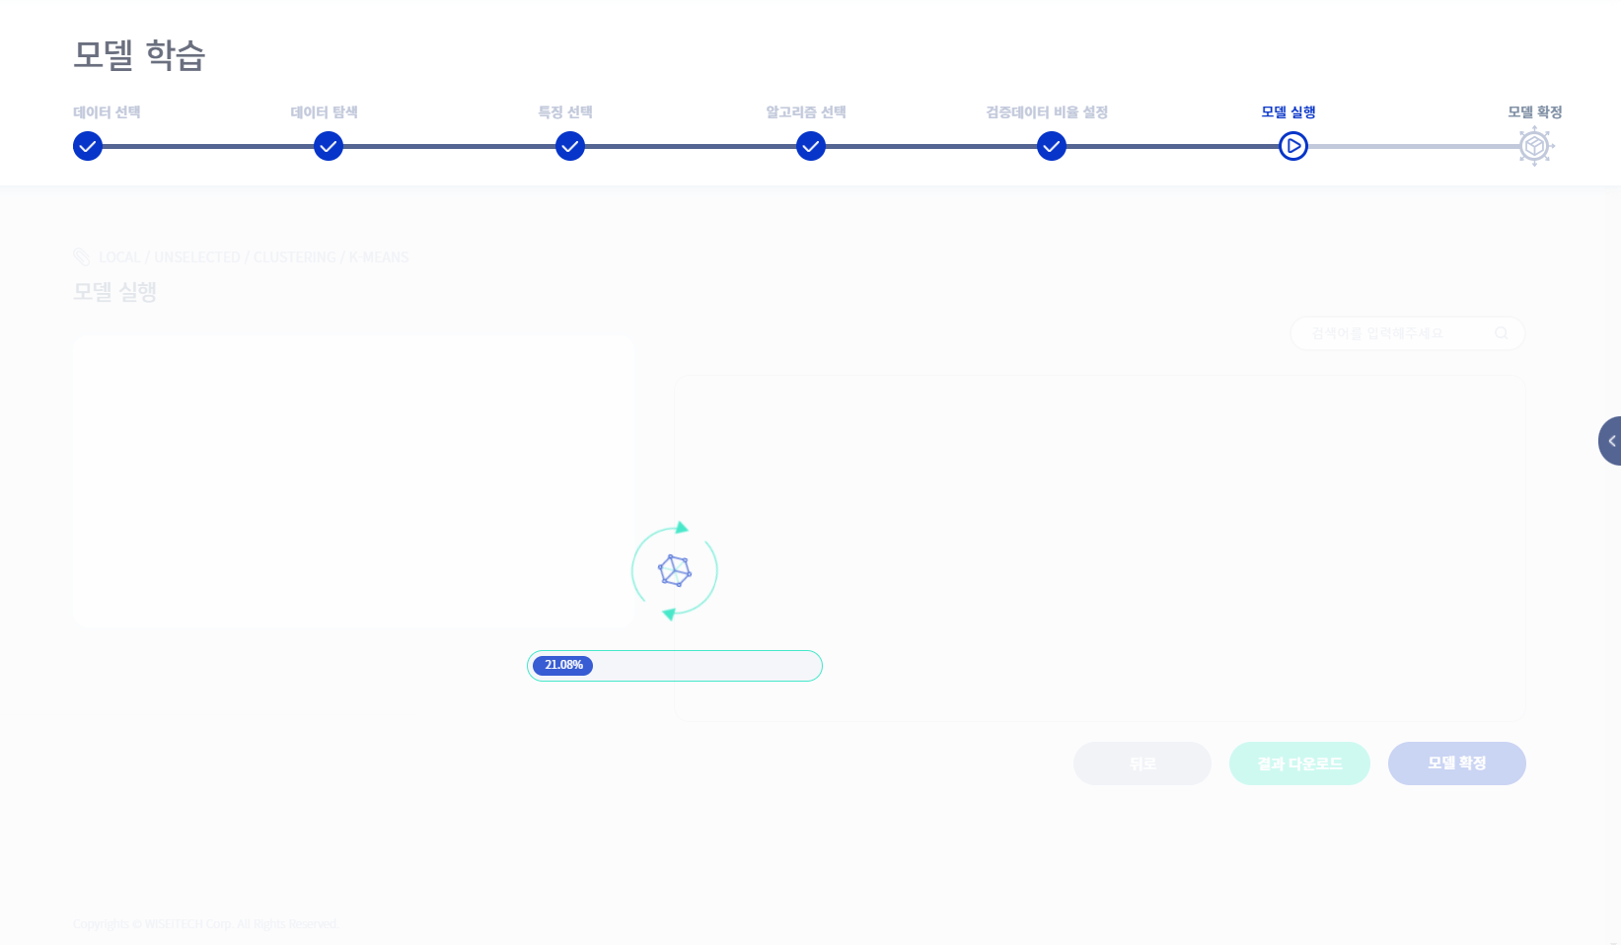
100%
Auto ML
URL : http://prophet.wise.co.kr

Slide 17
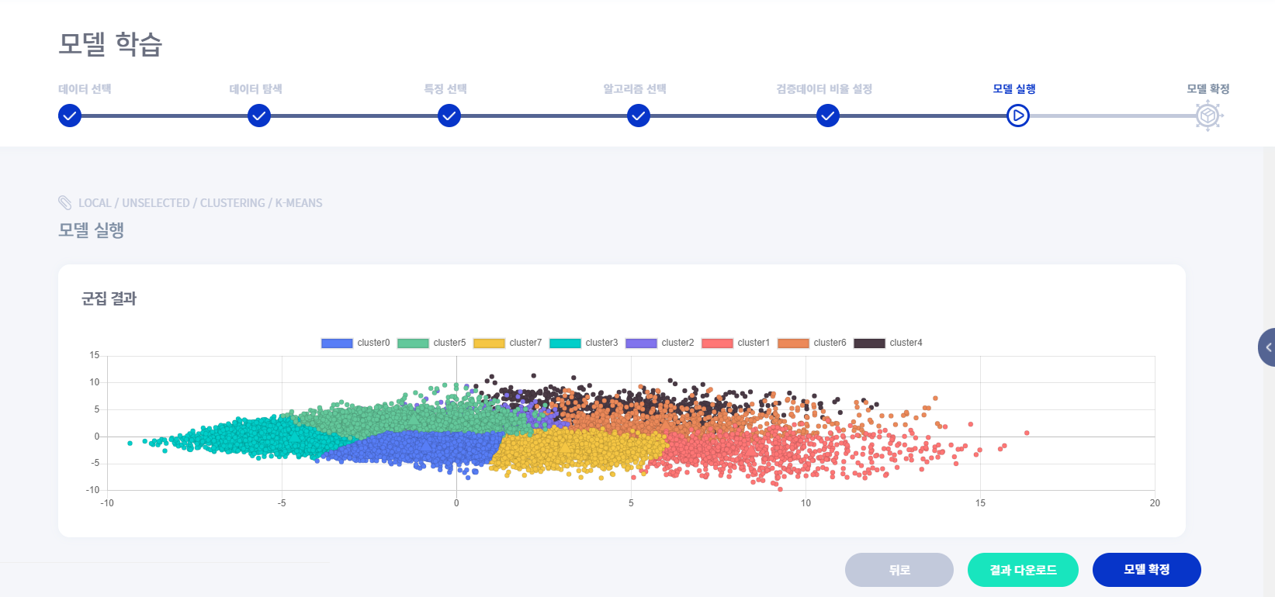
100%
Auto ML
URL : http://prophet.wise.co.kr

Slide 18
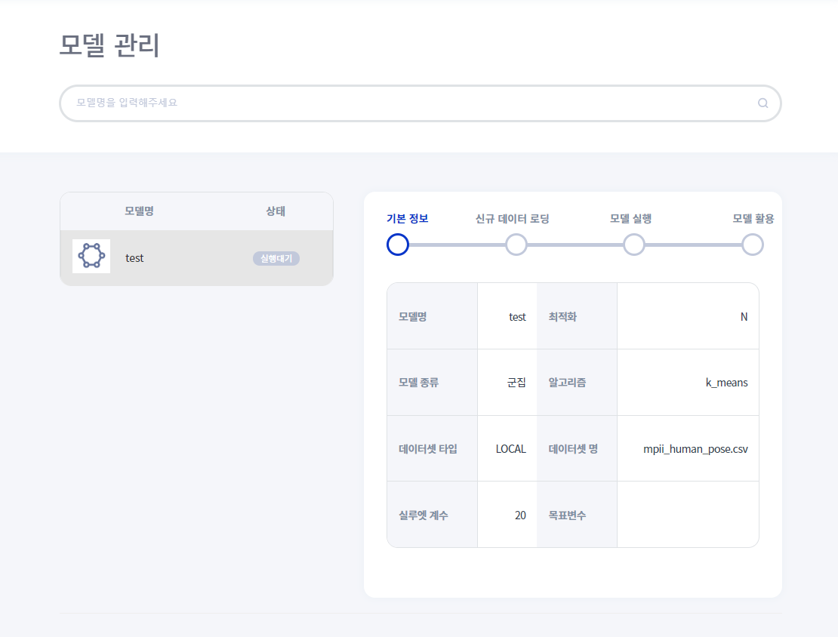
100%
Auto ML
URL : http://prophet.wise.co.kr

Slide 19
100%
Auto ML – [Classification] Decision Tree
Parameter to tune:
criteriion: gini or entropy max_depth: int
How to:
Max_depth starts at 15 if After adding +3, repeat +3 when the accuracy is higher than the threshold. elif After doing -3, repeat -3 when it rises higher than the threshold Stop when accuracy does not increase above threshold Repeat only when greater than 1 Criterion After setting gini to default, adjust max_depth. After tuning, replace with entropy and adopt entropy if the score is high.

Slide 20
100%
Auto ML – [Classification] Logistic Regression
Parameter to tune:
Penalty & solver: ‘newton-cg’ – [‘I2’,’none’] ‘lbfgs’ - [‘l2’, ‘none’]
How to:
All you have to do is enter 6 combinations and choose the one with the highest score.

Slide 21
100%
Auto ML - [Classification] SVM
Parameter to tune:
Kernel : poly, rgb, sigmoid Gamma : float C : float
How to:
First, we need to proceed differently for each kernel (repeat 3 times). Repeat c with [0.5, 1.0, 2.0, 4.0] ** Modifying the gamma value is the key. If =/2 and the accuracy goes higher than the threshold, repeat it. the accuracy does not increase more than threshold, stop. If elif =*2 the accuracy goes higher than the threshold, repeat it. the accuracy does not increase more than threshold, stop. The result tells you the best score parameter.

Slide 22
100%
Auto ML – [Clustering] Meanshift
Parameter to tune:
cluster_std : float
How to:
** This is the radius of the cluster. Repeat c with [0.1, 0.3, … 1.0, 2.0, 4.0] The result tells you the best score parameter.

Slide 23
100%
Auto ML – [Clustering] K means, GMM
Parameter to tune:
n_clusters: int
How to:
Find best n_clusters(k) Use silhouette score Start k = 3 Repeat silhouette score increase: k = k + 3 Return k which has highest silhouette score among k-3, k-2, k-1

Slide 24
100%
Auto ML – [Clustering] Agglomerative Clustering
Parameter to tune:
n_clusters: int linkage: single, average, complete. ward
How to:
Find best n_clusters(k) and best linkage method Use silhouette score for linkage in linkage_method: Start k = 3 Repeat silhouette score increase k = k + 3 Append k which has highest silhouette score among k-3, k-2, k-1 Return best score combination of k and linkage

Slide 25
03
Schedule & Collaboration Plan

Slide 26
100%
Project Schedule
MON | TUE | WED | THU | FRI | SAT | SUN
18 | 19 | 20 | 21 | 22 | 23 | 24
25 | 26 | 27 | 28 | 29 | 30 | 31
11.1 | 2 | 3 | 4 | 5 | 6 | 7
8 | 9 | 10 | 11 | 12 | 13 | 14
15 | 16
Proposal
Preprocessing
Meeting
Making
Classification / Clustering
Function
Meeting
Meeting
Finishing work & Prepare Final Presentation
Final

Slide 27

100%
정두화
Pre-processing
Classification-
Decision Tree,
Logistic
허서윤
Clustering - MeanShift
이정명
Classification-
SVM
최찬영
Clustering-
KMeans
GMM
Aggolmerative

Slide 28
100%
Thank you

